Slide 1


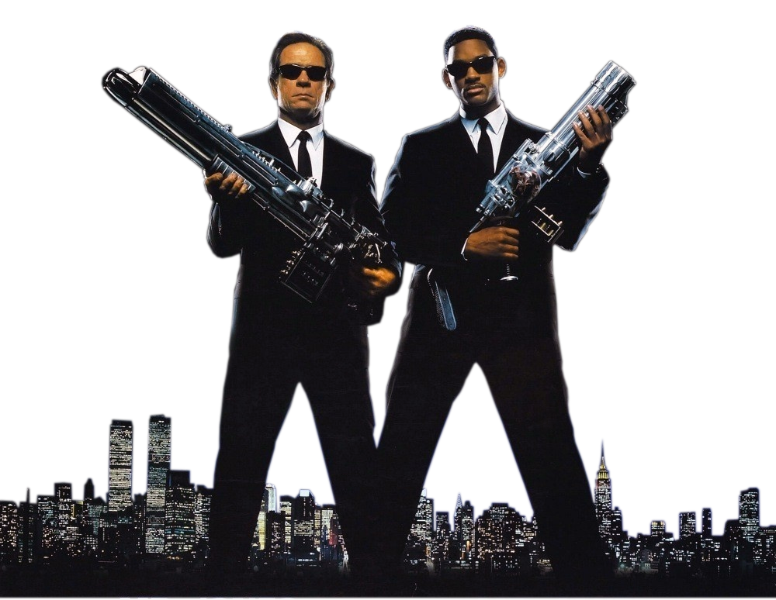
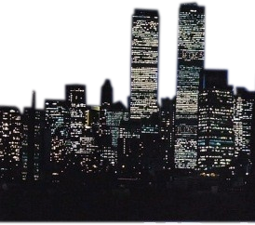
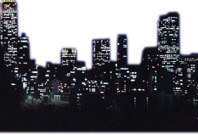
FBI
Department of
UFO Shenanigans
Men In Black
Travis Cook
Matthew Groh
Marshal Rittenger

Slide 2

UFO Sightings Dataset
NUFORC - (National UFO Reporting Center)
Data geolocated and time standardized UFO reports
80,000 plus reports
Dating back 1906 - 2014

Slide 3

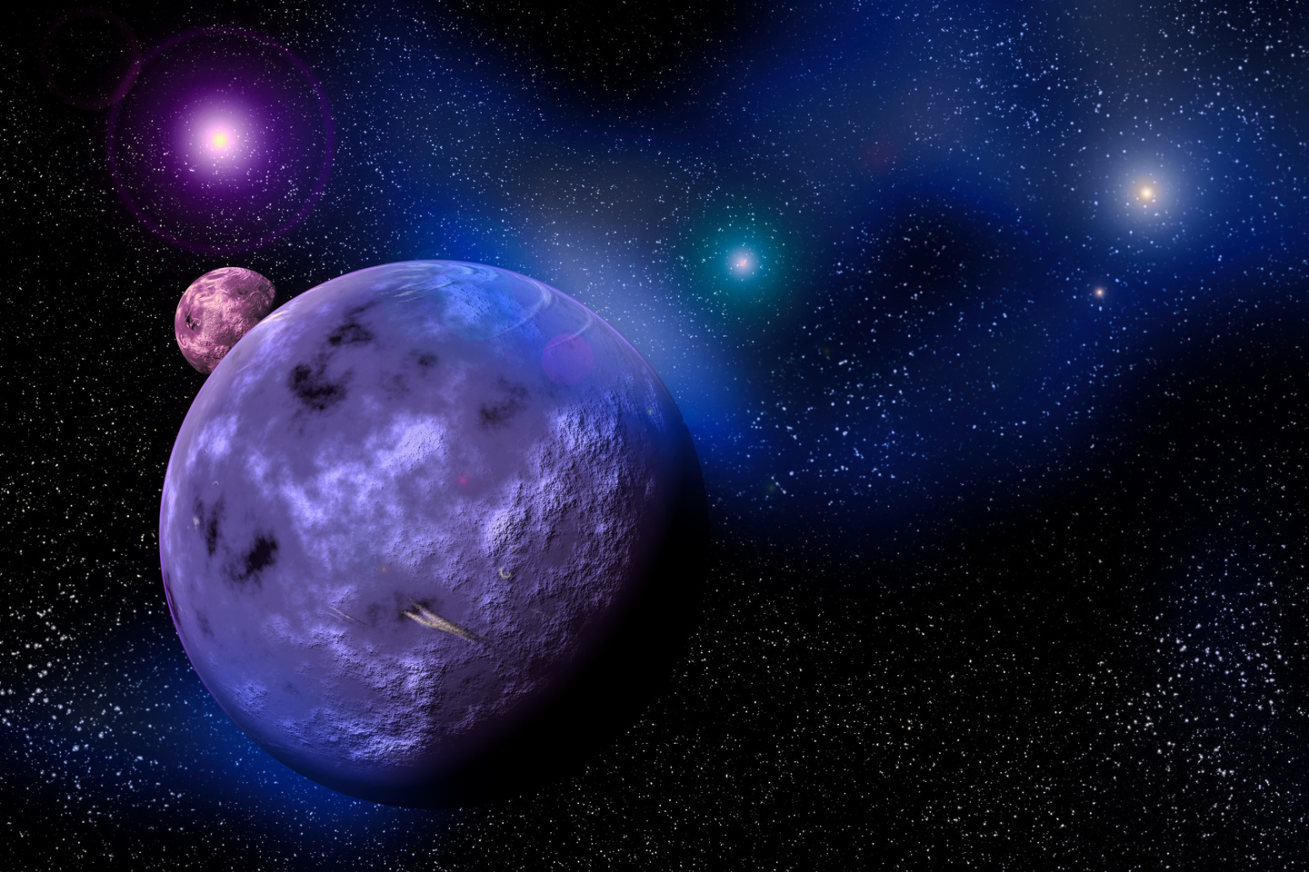
Encounter Hot Spots
Location:
Los Angeles
Chicago
Miami
Month:
July
Shape:
Circular lights in the sky

Slide 4

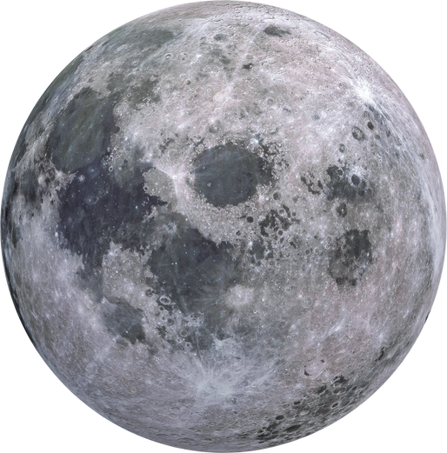

Other Visualizations
Technical
Challenges
Time of day
Duration of event
Bar chart of top 5 states
Script order
Group/count in JS
Linking clicks to map
Formatting traces

Slide 5
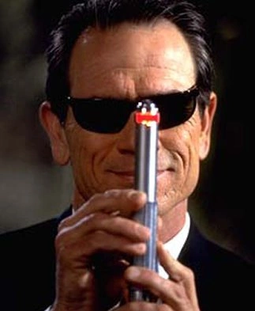
Thank You
Please look right here.

